Slide 1
Given at:
Job Hackers – SF 2020
The ROI of Learning Hour
by Llewellyn Falco
What the value in going to this conference?
You're here, you took time off work and paid real money to be here it safe to assume you see value in learning, but have you done the math?
The math turns out to be quite surprising, because it deals with systems involving compound interest.
Compound interest allows small changes to have **massive** effects over time.
Example 1:
Tim has a $100,000 loan at 100% interest. He pays **$8,333 a month**. At this rate it will take 50 years to pay off.
Allen has the same loan, but wants to pay it off **10 times** faster. How much more a month does he have to pay to achieve this?
Normal math would say 10 times is 8,333 X 10.
But the actual answer is just a mere seventy dollars more each month to bring the time down a factor of 10 times.
Surprizing? Yeah!
So come hear a combination of personal experiences and mathematical visualization explaining just how much you are getting out of doing a bit of learning everyday.
Example 2:
Team A works 8 hours a day.
Team B works 7 hours a day and spends 1 hour a day learning. This learning improves the team's output by 1%. How many days will it be until Team B has produced as much as Team A?
![Answer: 28 days](https://pbs.twimg.com/media/CS7U4EvWoAAtMmx.png:large)
Notes:
The ROI of Relentless Learning
by Llewellyn Falco
We are about to embark on a lot of learning hours.
But are they it worth it? Let’s do the math….
The math turns out to be quite surprising, because it deals with systems involving compound interest.
Compound interest allows small changes to have **massive** effects over time.
So come hear a combination of personal experiences and mathematical visualization explaining just how much you are getting out of doing a bit of learning everyday.

Slide 2
ToDo:
Talk about current time learning
Possible
Try a video hour…. Nordstrom Innovation Lab- Sunglass iPad App Case Study

Slide 3

ROI on Learning Hour
@LlewellynFalco

Slide 4
Resources
github.com/isidore/Talks/blob/master/RoiOnLearningHour.md

Slide 5
Push Ups

Slide 6


Slide 7
Habit

Slide 8
Trigger
Routine
Reward

Slide 9
Trigger
(game over)
Routine
(play again)
Reward
(not bored)

Slide 10
Trigger
(game over)
Routine
(do 1 pushup)
Reward
(not bored)

Slide 11
micro Habits after I ____ Then I ____

Slide 12
Starting Point ?

Slide 13
Important
&
Urgent
Important
but
Not Urgent
(Manage)
(Focus)
Important ➔
Not Important
but
Urgent
Not Important
&
Not Urgent
(Avoid)
(Limit)
⬅ Urgent

Slide 14
Important
&
Urgent
Important
but
Not Urgent
(Manage)
(Focus)
Important ➔
Not Important
but
Urgent
Not Important
&
Not Urgent
(Avoid)
(Limit)
⬅ Urgent

Slide 15
Important
&
Urgent
Important
but
Not Urgent
(I’m on it)
(When?)
Important ➔
Not Important
but
Urgent
Not Important
&
Not Urgent
(also on it)
(procrastination)
⬅ Urgent

Slide 16
Important
&
Urgent
Important
but
Not Urgent
(I’m on it)
(When?)
Important ➔
Not Important
but
Urgent
Not Important
&
Not Urgent
(also on it)
(procrastination)
⬅ Urgent

Slide 17
Culture Norms

Slide 18
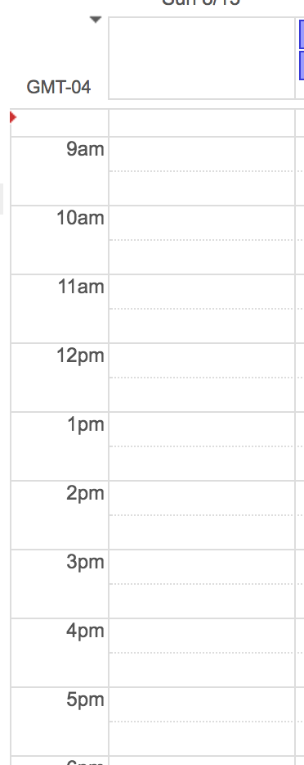
Mob w/ Team 1
Learning Hour
Lunch
Mob w/ Team 2
Mob w/ Team 3

Slide 19
Learning Hour

Slide 20
Koans
Katas
TDD (paired & mobbed)
Fake it till you make it
ApprovalTests
Combinatorial testing
Git
PowerPoint karaoke
Peel & Slice techniques
Functional Code Poke testing
Unit story writing
Video hour w/ lean coffee
Sparrow Decks
lfal.co/LearningHourTopics

Slide 21
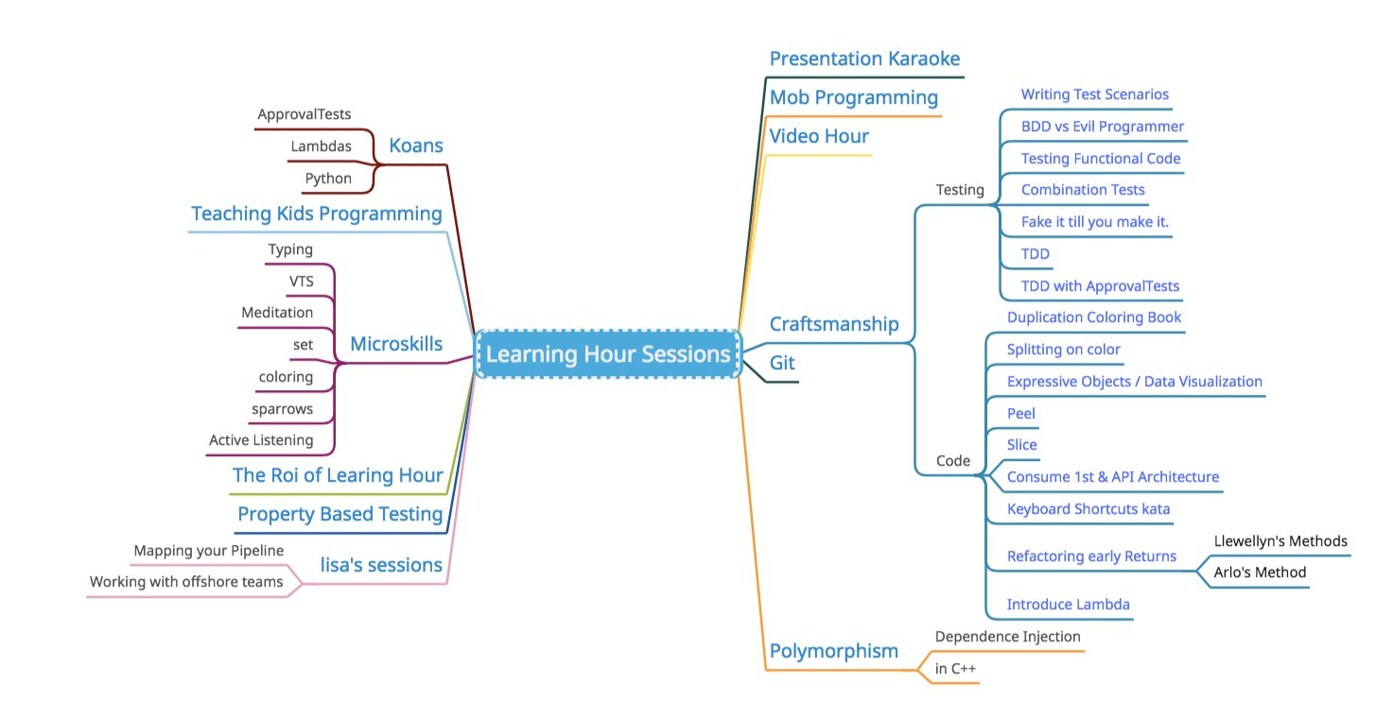

Slide 22
Small Gains over time
Important
but
Not Urgent
Important
but
Not Urgent

Slide 23


Slide 25



Slide 26


Slide 27
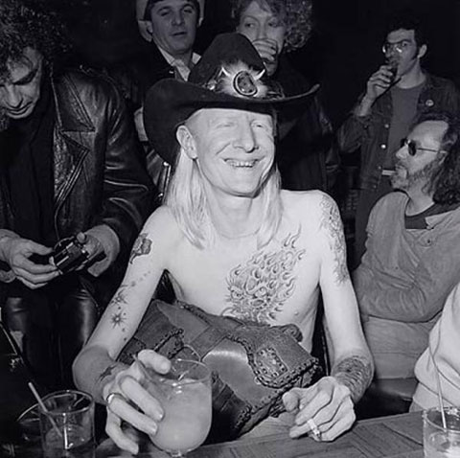
Johnny Winter’s manager had been slowly lowering his methadone dosage for 3 years without Johnny’s knowledge. As a result, Johnny was completely clean of his 40 year heroin addiction for over 8 months before being told he was finally drug free
*http://www.brooklynvegan.com/johnny-winter-r/

Slide 28
Small Gains over time

Slide 29

A swimming pool is not just a bigger bathtub
@LlewellynFalco

Slide 30
Bathtub
a tank or artificial basin filled with water

Slide 31
Swimming Pool
a large tank or artificial basin filled with water
larger

Slide 32

PoolPump

Slide 33

Swimming

Slide 34

Pool Party

Slide 35

Diving Board

Slide 36
Good Point!
Who Cares?

Slide 37
Virtual machine vs. Docker

Slide 38
Sprints Releases vs. Continuous Deployment

Slide 39
Test First vs. Test After

Slide 40
Mob w/ Team 1
Learning Hour
Lunch
Compound
Interest
Mob w/ Team 2
Mob w/ Team 3

Slide 41
Infinite TASKS

Slide 42
1
2
3
4
5
6

Slide 43
1/2 = .5 1/4 = .25 1/8 = .125 1/16 = .0625 1/32 = 0.03125 … 1/x = 0

Slide 44
SUPER TASKS

Slide 45
1
½
¼
1/8
1/16
1/32

Slide 46
1/1 = 1 [1] 1/2 = .5 [1.5] 1/4 = .25 [1.75] 1/8 = .125 [1.875] 1/16 = .0625 [1.9375] 1/32 = 0.03125 [1.96875] … 1/∞ = 0 [2]

Slide 47
1 (1) * .99 (1 * .99) * .99 = 1 * .99² (1 * .99 * .99) * .99 = 1 * .99³ (1 * .99 * .99 * .99) * .99 = 1 * .99⁴ … 1 * .99^{N}

Slide 48
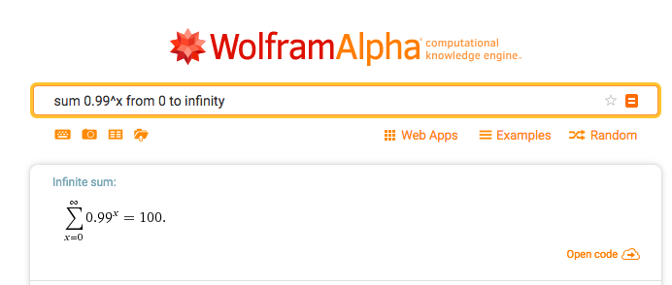

Slide 49
Compound Interest

Slide 50
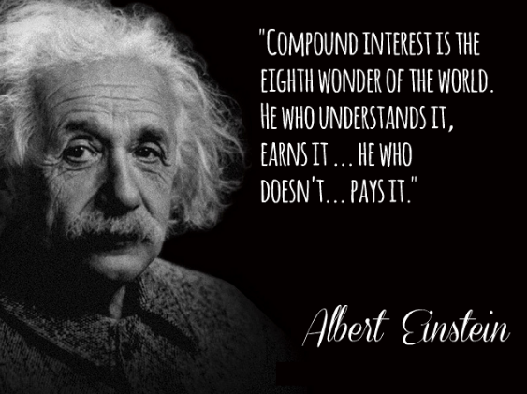

Slide 51
10 X

Slide 52
What does 10X look like?

Slide 53
$1 @ 10% interest For 1 Year
Total: $1.10
$1 @ 100% interest For 1 Year
Total: $2.00

Slide 54
$1 @ 10% interest For 20 Years
Total: $6.73
$1 @ 100% interest For 20 Years
Total: $1,048,576.00

Slide 55
Gross: $100,000 Gross: $145,000
Overhead: $95,000
($5K Profit)
($50K Profit)

Slide 56
Loan: $100,000 @ 10% interest $839 $2124
(50 years)
(5 years)

Slide 57
Interest: $100,000 @ 100% interest $8,333
(50 years)
$8,402
(5 years)

Slide 58
Person 1: $100 a Month for 17 Years
Person 2: $100 a Month for 17 Years

Slide 59
Person 1: $100 a Month for 17 Years
Person 2: $100 a Month for 17 Years

Slide 60
Person 1: $100 a Month for 17 Years
$530k
$53k
Person 2: $100 a Month for 17 Years

Slide 61
Unsurprisingly, the team did not achieve 10x productivity. In fact, we found our productivity to be almost the same as it was before…Your mileage may vary, but as far as we’re concerned it’s a resounding NO.
My Experience With MobProgramming
Is the product higher quality? Is there better test coverage? Is the code idiomatic and does it follow best practices? Are the chances of a bug crawling into the product minimized? From our experience this is the most emphatic YES of all the concerns listed above. Not only does having everyone together increase accountability and awareness, but mistakes that may be made by more junior developers are more likely to be caught. Furthermore, when our QA engineer was in the mob, he gained a much better sense of how to go about testing the feature as thoroughly as possible.
http://engineering.appfolio.com/appfolio-engineering/2014/03/17/my-experience-with-mob-programming

Slide 62
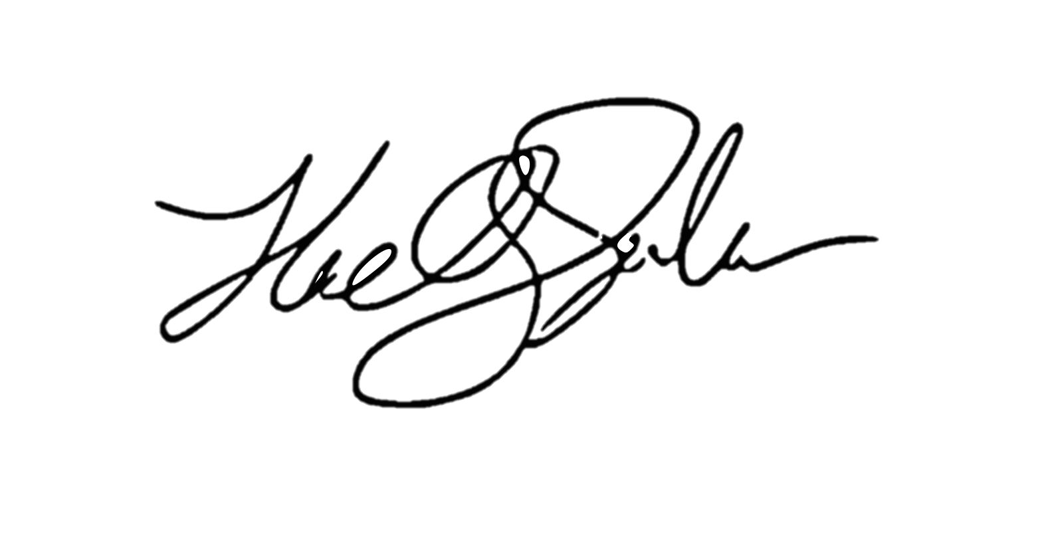
ROI of investing1 hour a day
for a 1% increase ( 5 minutes )
5x (1 year)
4x (10 months)
Output
2x (6 months)
3x (8.5 months)
28 days
Llewellyn Falco

Slide 63
1.00 ^ 365 = 1
1.01 ^ 365 = 37.78

Slide 64
How Much TIME can you spend LEARNING AT WORK?

Slide 65
1 hour
7 hour

Slide 66
4 hour
4 hour

Slide 67
6:45
1:15

Slide 68
Task board
To Do
Doing
Done

Slide 69


Task board
To Do
Doing
Done
Feature 1
Feature 2
Team
Improvement
Arlo Belshee
Ashley Johnson

Slide 70
Task board
To Do
Doing
Done
100%
(Features)
0%
(Improvements)

Slide 71
?%
(Features)
?%
(Improvements)

Slide 72
ROI MODELS of Learning http://lfal.co/LearningHour

Slide 73
Diminishing returns

Slide 74
Diminishing Returns

Slide 75
ABSOLUTE

Slide 76
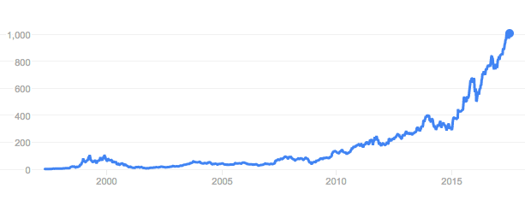
RELATIVE
3,138.38

Slide 77
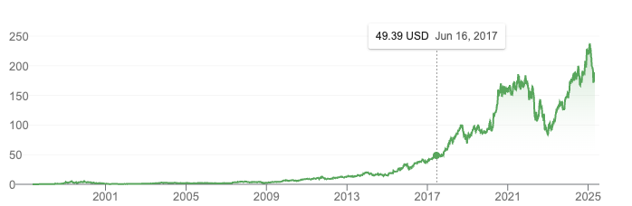
RELATIVE
3,138.38

Slide 78
Mob w/ Team 1
Learning Hour
Lunch
Benefits
Mob w/ Team 2
Mob w/ Team 3

Slide 79
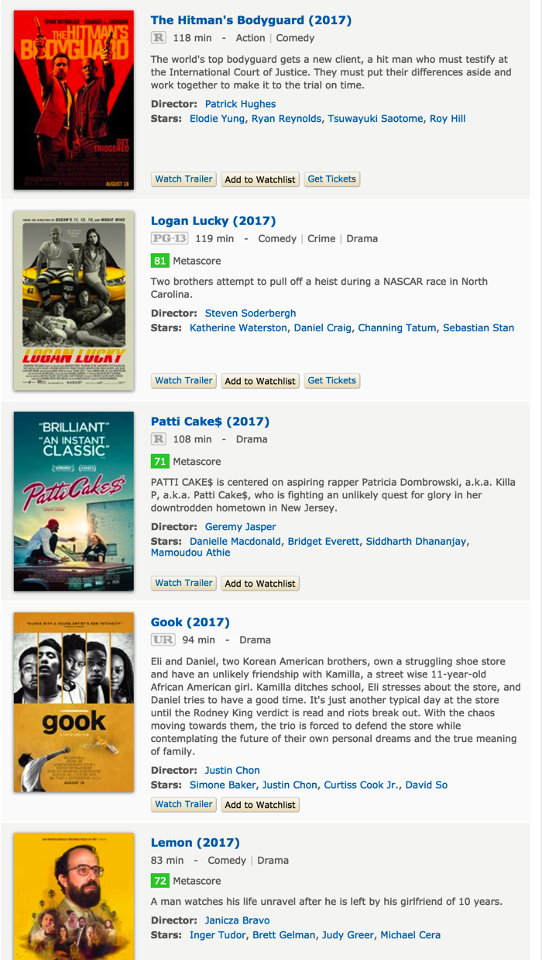
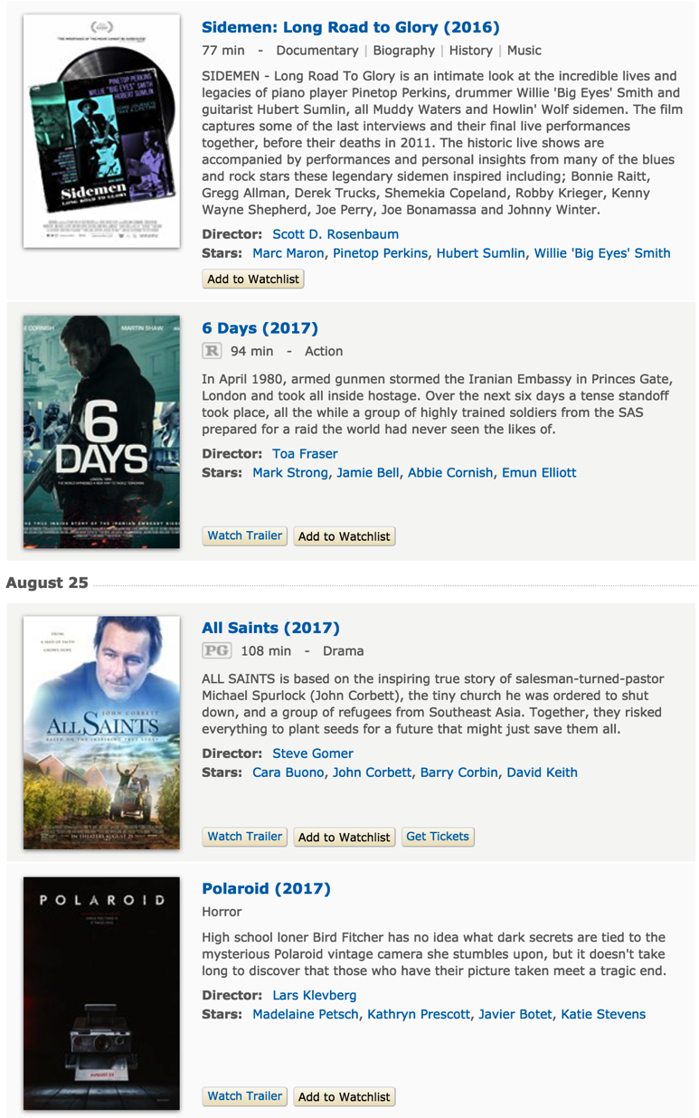

Slide 80
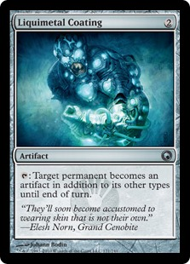
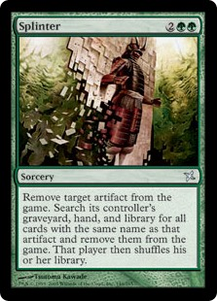
COMBOs

Slide 81
Passion

Slide 82
Passionate People Learning

Slide 83
Thresholds
* http://revisionisthistory.com/episodes/03-the-big-man-cant-shoot
Notes:
Wilt Chamberlain

Slide 84
Room Setup

Slide 85
Types of knowledge
PROFICIENCY
FLUENCY
AWARENESS

Slide 86
Lecture
Screen
Audience
Awareness

Slide 87
Mob
Screen
Laptop
White Board
Driver
Mob
(people rotate counter-clockwise every 4 mins)
Navigator
Facilitator
Audience
Proficiency

Slide 88
Pairs
Screen
Fluency

Slide 89
Workshop
Screen
Awareness
Proficiency
Fluency

Slide 90
a MICROSKILLS WEEK
Fluency

Slide 91


Slide 93
Returns on Learning

Slide 94
Machine Learning
?
time➔

Slide 95
Low Risk, Low Return

Slide 96
Existing Tools

Slide 97
Java Lambda’s
?
time➔
Existing Tools

Slide 98
New Tools

Slide 99
Spring Boot
?
time➔
New Tools

Slide 100
New Paradigms

Slide 101
Elixir
?
time➔
New Paradigms

Slide 102
High Risk, High Return

Slide 103
What does your Portfolio look like?

Slide 104
Important
&
Urgent
Important
but
Not Urgent
(Manage)
(Focus)
Important ➔
Not Important
but
Urgent
Not Important
&
Not Urgent
(Avoid)
(Limit)
⬅ Urgent

Slide 105
Retrospective

Slide 106
FEEDBACK

Slide 107
Pairing/Mobbing

Slide 108

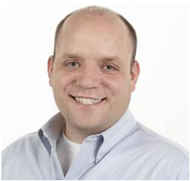
“If you want a learning culture, the first rule is:
you don't wait for after working hours
for learning to begin”
Ryan Ripley
#58 Agile Coaching Strategies

Slide 109
“The difference between
a Learning Hour and
a Meeting where you learn something
is that a learning hour would be useful to people who don’t work for your company”

Slide 110
ROI of investing1 hour a day
for a 1% increase ( 5 minutes )
5x (1 year)
4x (10 months)
Output
2x (6 months)
3x (8.5 months)
28 days
Llewellyn Falco

Slide 111
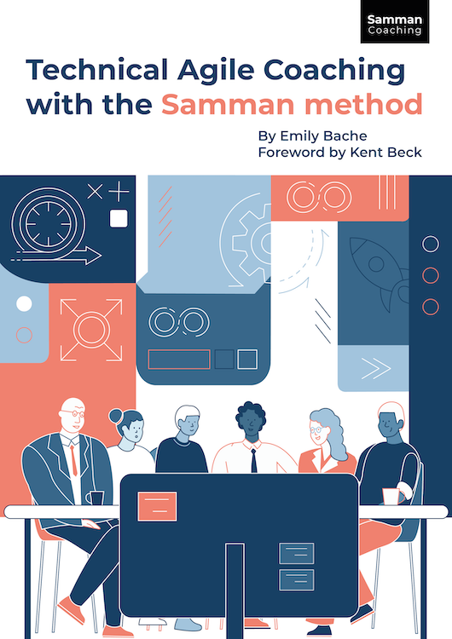
www.sammancoaching.org
Emily Bache

Slide 112
SPEND MORE TIME LEARNING AT WORK

Slide 113
Make LEARNING a REGULAR PART OF WORK

Slide 114
Review your retirement accounts

Slide 115
“The best time to plant a tree is 20 years ago.
The second-best time is now.”

Slide 116

Thank YOU (please connect via LinkedIn and Twitter)
@LlewellynFalco
youtube.com/isidoreus
LlewellynFalco.Blogspot.com approvaltests.com

